Slide 1

Get Em’ Moving
Managing job changes in Workday!
Facilitated by:
Deedee Castrodale
Alissa price
Nolan Wade

Slide 2

Agenda:
Transfers
Lateral Transfers
Promotions
Business Title Changes
Terminations

Slide 3

Objectives:
Know how to identify and classify the appropriate job change course of action.
Become familiar with how job changes are processed and executed in Workday.
Review the impact that job changes have on compensation and benefits.

Slide 4

Questions ??? – Chat Box
Please post your questions in the chat box which will be monitored and answered in flight.

Slide 5

Job Change: Transfers
A transfer occurs when an employee takes a position under a new manager in a different supervisory organization. It may be in a different location and include a change in compensation.

Slide 6
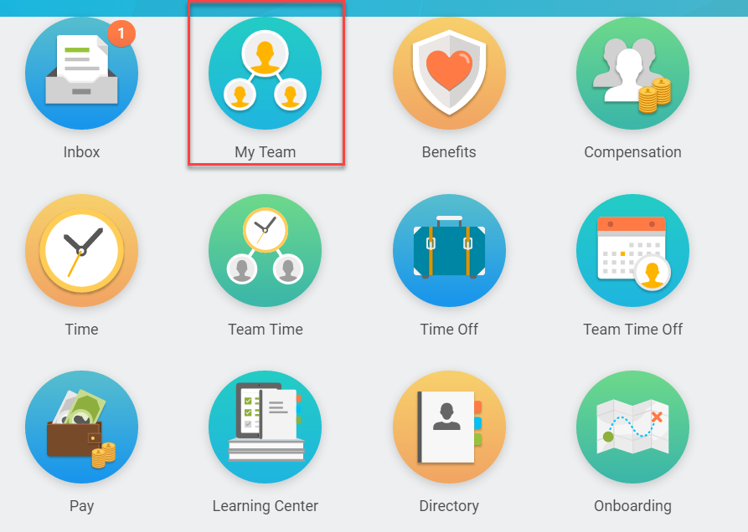
Transfers…My Team Worklet
All job change tasks and reports are accessed from the My Team worklet.
Notes:
Click on the Team Time worklet on your home screen.

Slide 7
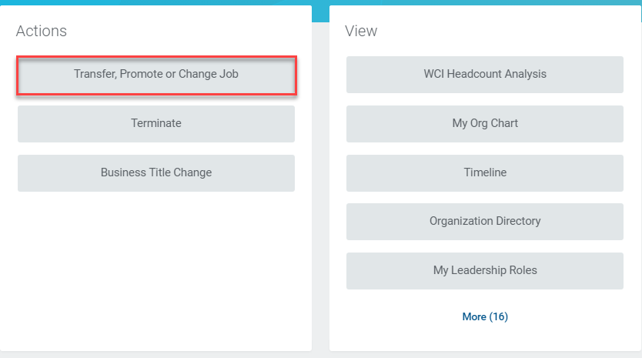
Transfers…Transfer, Promote or Change Job
Click here!
Notes:
Click on the Team Time worklet on your home screen.

Slide 8
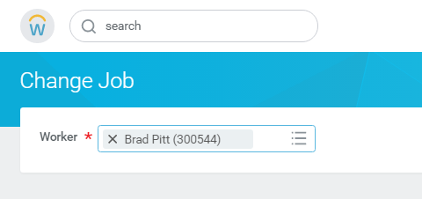
Transfers…Select Worker
Enter the name of the worker to be transferred.
Notes:
Click on Review Time under Actions.

Slide 9
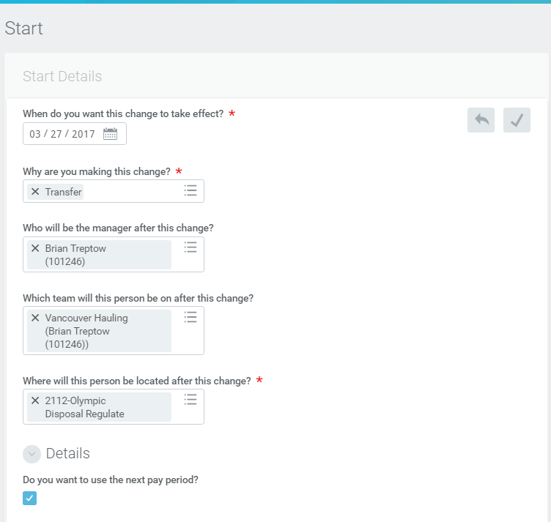
Transfers…Start Details Page (Sending Manager)
The Sending Manager enters the date the transfer should go in effect
Select Transfer
Accurately selecting the new manager will also default the supervisory org or team. Consult an HRIS manager if unsure which manager to select
If applicable, select new location
Notes:
Click on Review Time under Actions.

Slide 10
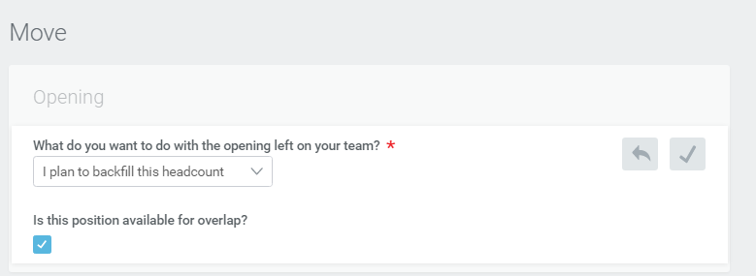
Transfers…Move Page (Sending Manager)
You Can:
Backfill Position
Move Headcount
Close Position
Always check this box so recruiting can begin to backfill the position
Notes:
Click on Review Time under Actions.

Slide 11
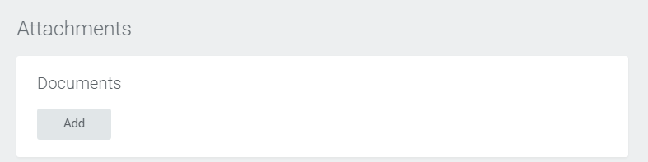
Transfers…Attachments Page (Sending Manager)
Attach any documents that support the transfer
Notes:
Click on Review Time under Actions.

Slide 12
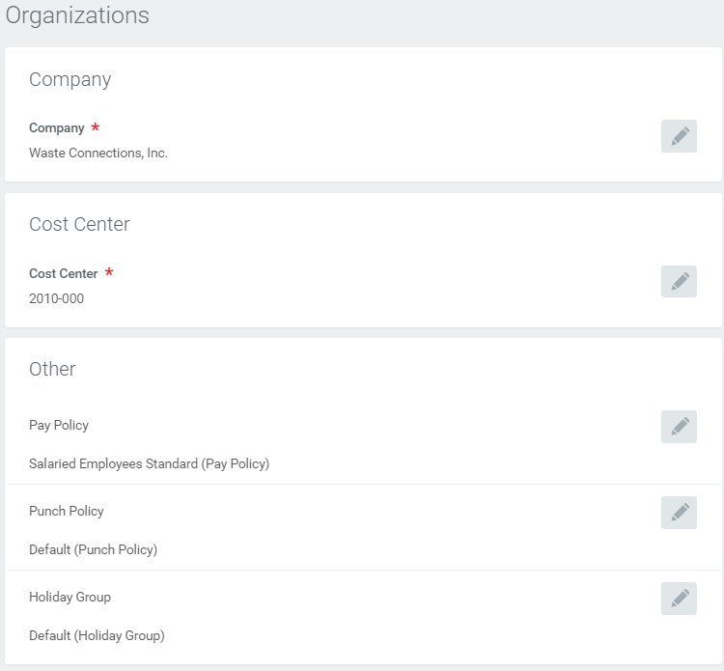
Transfers…Organizations Page (Sending Manager)
Update the organization assignments per the transferring position
Notes:
Click on Review Time under Actions.

Slide 13
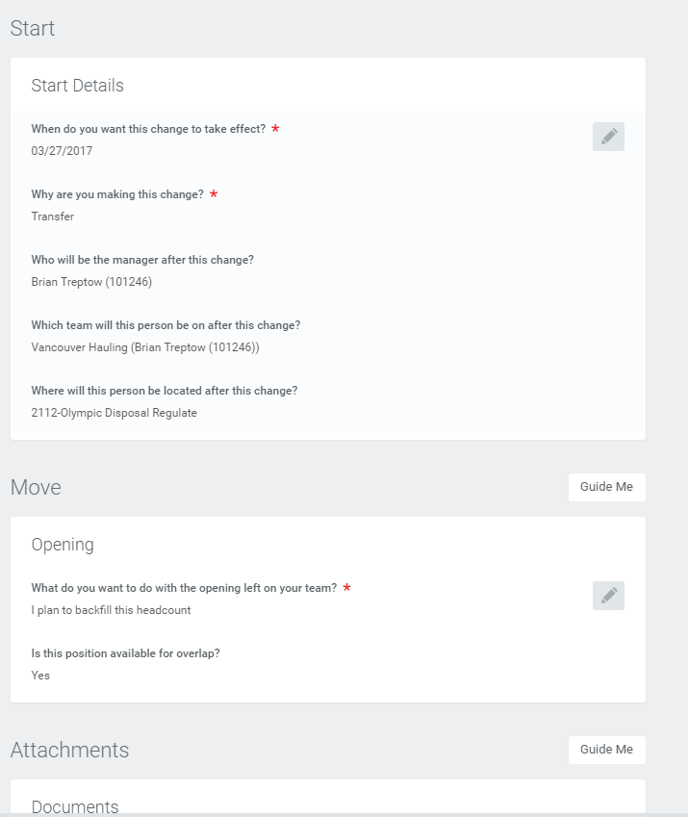
Transfers…Summary Page (Sending Manager)
Review and/or edit all details from the Summary Page.
Click Submit to send to Receiving Manager
Notes:
Click on Review Time under Actions.

Slide 14
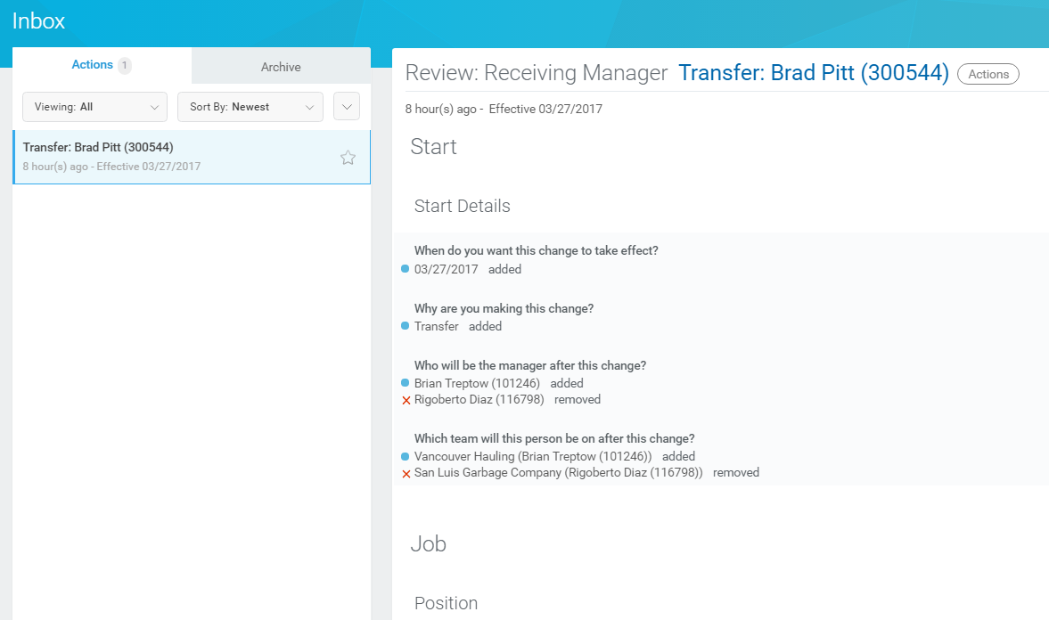
Transfers…Receiving Manager Inbox Notification
Receiving manager receives an inbox notification of the transfer.
Scroll down the page to review, edit, and approve transfer details.
Notes:
Click on Review Time under Actions.

Slide 15
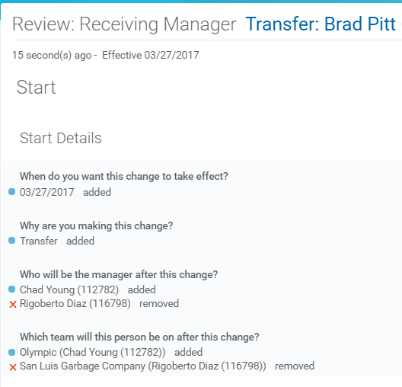
Transfers…Start Details (Receiving Manager)
Review the information in the Start Details section
Edit as necessary
Save any changes
Notes:
Click on Review Time under Actions.

Slide 16
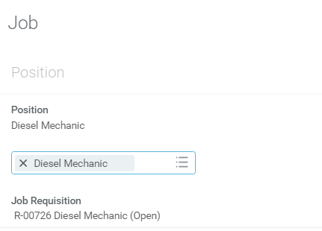
Transfers…Job Details (Receiving Manager)
Click the Prompt in the Position field to select the position the employee is transferring into.
NOTE: In order to successfully transfer an employee, a position MUST have previously been created using the requisition approval process in the Receiving Manager’s supervisory organization.
Notes:
Click on Review Time under Actions.

Slide 17

Transfers…Job Profile (Receiving Manager)
Select the appropriate Job Profile for the new positon
Keep in mind that the Job Profile ties back to the GL code
The new job profile appears as “ Mechanic added” while the prior job profile remains on the page and appears as “ X Driver removed”
Notes:
Click on Review Time under Actions.

Slide 18
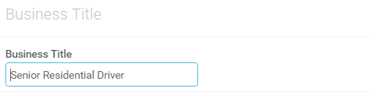
Transfers…Business Title (Receiving Manager)
If required, enter the new business title
Notes:
Click on Review Time under Actions.

Slide 19
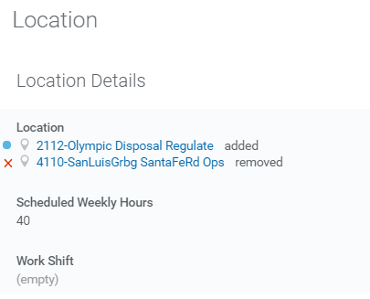
Transfers…Location Details (Receiving Manager)
If required, edit location details
Notes:
Click on Review Time under Actions.

Slide 20
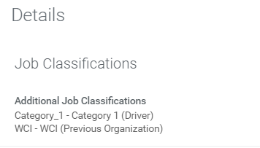
Transfers…Details (Receiving Manager)
If required, edit the Details section of the page
Notes:
Click on Review Time under Actions.

Slide 21
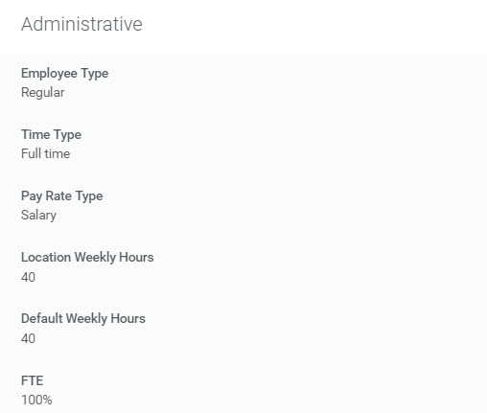
Transfers…Administrative (Receiving Manager)
If required, edit the Administrative section of the page
Notes:
Click on Review Time under Actions.

Slide 22
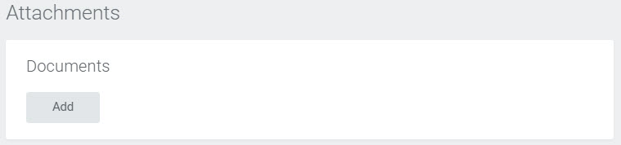
Transfers…Attachments (Receiving Manager)
Review and/or attach any documents to support the transfer
Notes:
Click on Review Time under Actions.

Slide 23
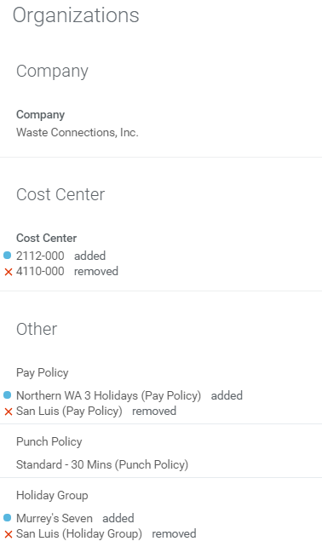
Transfers…Organizations (Receiving Manager)
Edit the Organizations by updating the:
Cost Center
Pay Policy
Punch Policy
Holiday Group
Notes:
Click on Review Time under Actions.

Slide 24


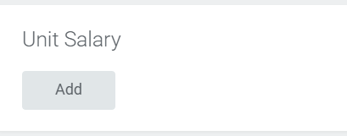
Transfers…Compensation (Receiving Manager)
Edit compensation by clicking Add for the compensation type or:
Click Add for a salary-based position
Click Add for an hourly-based position
Click Add for a Unit Salary-based position
Notes:
Click on Review Time under Actions.

Slide 25
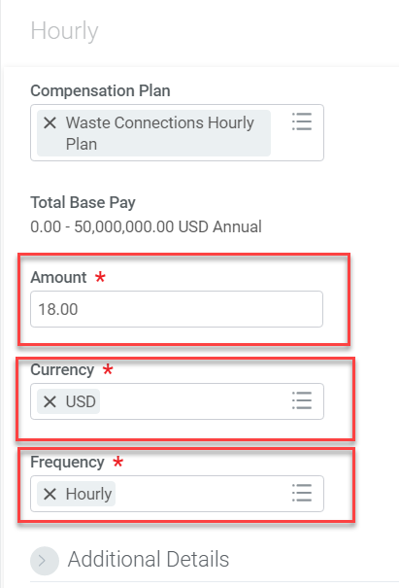
Transfers…Compensation (Receiving Manager) cont.
Select the appropriate compensation plan
Enter the amount, currency, and frequency
Make sure you have selected the correct option for Frequency
Notes:
Click on Review Time under Actions.

Slide 26
Transfers…Compensation (Receiving Manager) cont.
Select the appropriate compensation plan
Enter the amount, currency, and frequency
Make sure you have selected the correct option for Frequency
Notes:
Click on Review Time under Actions.

Slide 27
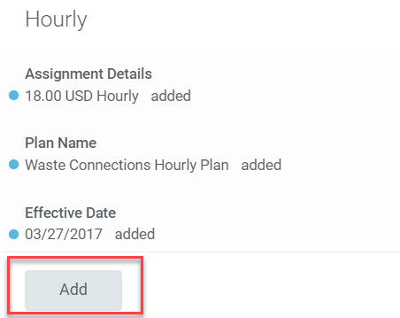
Transfers…Compensation (Receiving Manager) cont.
For hourly employees, the vacation plan must be added again
Click Add
Notes:
Click on Review Time under Actions.

Slide 28
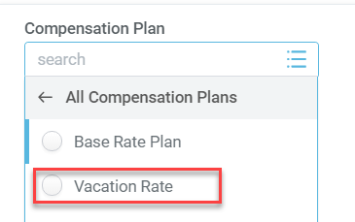
Transfers…Compensation (Receiving Manager) cont.
From the drop-down menu, select “All Compensation Plans”
Choose “Vacation Rate”
Notes:
Click on Review Time under Actions.

Slide 29
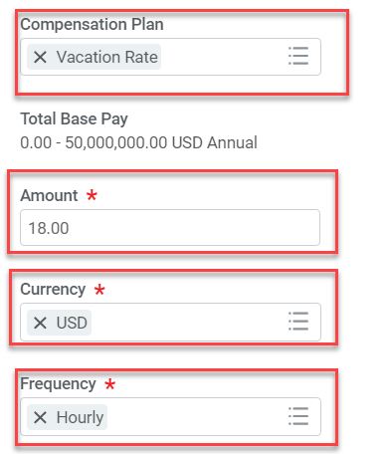
Transfers…Compensation (Receiving Manager) cont.
Select the “Vacation Rate” as the compensation plan
Enter the hourly amount the employee will be paid as well as the currency and frequency
Again, make sure you have selected the correct option for Frequency
Notes:
Click on Review Time under Actions.

Slide 30
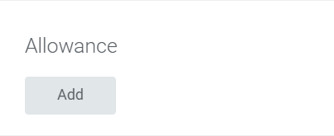

Promotions…Compensation (Receiving Manager) cont.
Auto-allowance, gas card, etc., please contact your Payroll Partner for assistance in setting up this type of payment in the system
Employee benefits are only affected when moving from union to non-union and vice versa.
Notes:
Click on Review Time under Actions.

Slide 31

Job Change: Lateral Transfers
A lateral transfer occurs when an employee is placed in a different position within the same supervisory organization and the manager, location, and compensation may remain the same.

Slide 32
Lateral Transfers…My Team Worklet
All job change tasks and reports are accessed from the My Team worklet.
Notes:
Click on the Team Time worklet on your home screen.

Slide 33
Lateral Transfers…Transfer, Promote or Change Job
Click here!
Notes:
Click on the Team Time worklet on your home screen.

Slide 34
Lateral Transfers…Select Worker
Enter the name of the worker to be transferred.
Notes:
Click on Review Time under Actions.

Slide 35
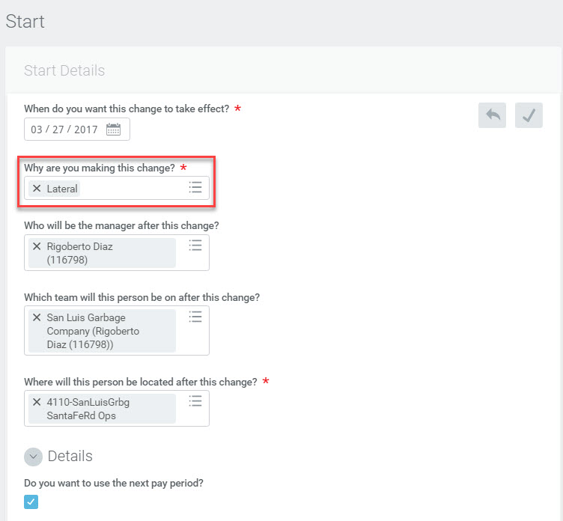
Lateral Transfers…Start Details Page (Hiring Manager)
Enter date the lateral transfer should go in effect
Select Lateral
The manager and the team typically remains the same for a lateral transfer
The location typically remains the same for a lateral transfer
Notes:
Click on Review Time under Actions.

Slide 36
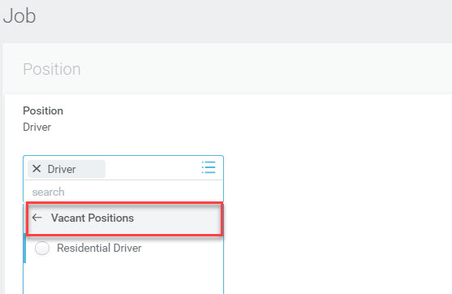
Lateral Transfers…Job Page (Hiring Manager)
Edit the Position section of the Job Page
NOTE: To successfully transfer an employee, a position MUST have previously been created using the requisition approval process in the Receiving Manager’s supervisory organization.
Click the prompt and select Vacant Positions
Select the position for the lateral transfer and save the changes
Notes:
Click on Review Time under Actions.

Slide 37
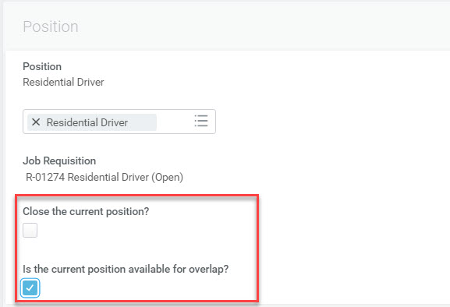
Lateral Transfers…Job Page cont. (Hiring Manager)
Decide what to do with the current position
Click to close the current position
If the position will be backfilled, click here to trigger the recruiting process
Notes:
Click on Review Time under Actions.

Slide 38
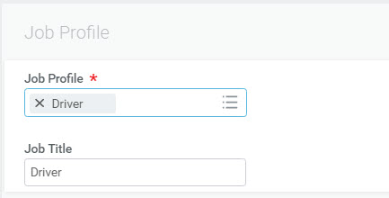
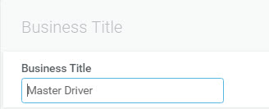
Lateral Transfers…Job Page cont. (Hiring Manager)
Enter the appropriate job profile for the position.
Remember that the job profile links back to the GL code.
Enter the business title. Click Next
Notes:
Click on Review Time under Actions.

Slide 39
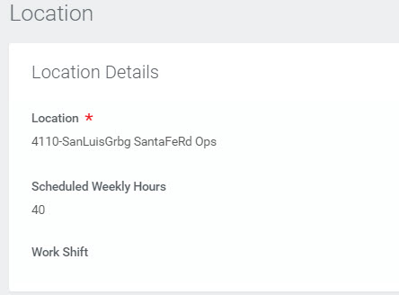
Lateral Transfers…Location Page (Hiring Manager)
The Location Page displays but because lateral transfers don’t include location changes, click Next.
Notes:
Click on Review Time under Actions.

Slide 40
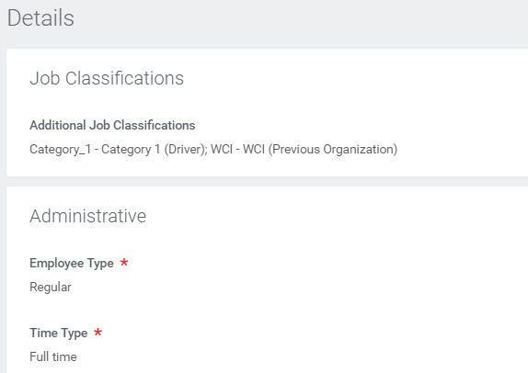
Lateral Transfers…Details Page (Hiring Manager)
The Details Page displays. Unless there are any job classification and/or administrative changes to enter, click Next.
Notes:
Click on Review Time under Actions.

Slide 41
Lateral Transfers…Attachments Page (Hiring Manager)
The Attachments Page displays. Attach any documents to support the lateral transfer and click Next.
Notes:
Click on Review Time under Actions.

Slide 42
Lateral Transfers…Organizations Page (Hiring Manager)
Edit the Allowed Organizations by updating the:
Cost Center
Pay Policy
Punch Policy
Holiday Group
Notes:
Click on Review Time under Actions.

Slide 43
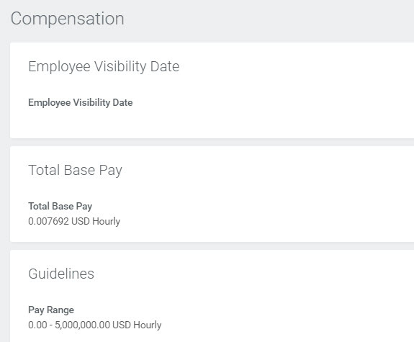
Lateral Transfers…Compensation Page (Hiring Manager)
Lateral transfers don’t typically involve compensation changes. Click Next.
Notes:
Click on Review Time under Actions.

Slide 44
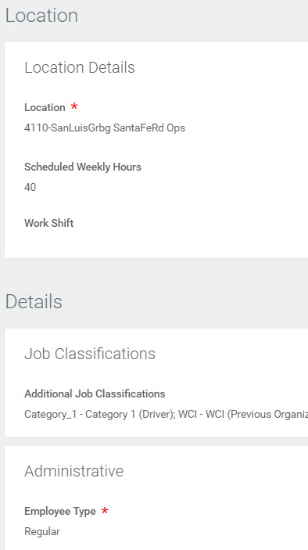
Lateral Transfers…Summary Page (Hiring Manager)
The Summary page allows you to edit any of the details entered on the previous pages. Once done, click Submit.
The lateral transfer will then route for managerial approval.
Notes:
Click on Review Time under Actions.

Slide 45

Job Change: Promotions
When an employee is promoted, he/she will be moved into a different position which may possibly include a new supervisory organization, location, and/or compensation increase.

Slide 46
Promotions… My Team Worklet
All job change tasks and reports are accessed from the My Team worklet.

Slide 47
Promotions…Transfer, Promote or Change Job
Click here!
Notes:
Click on the Team Time worklet on your home screen.

Slide 48
Promotions…Select Worker
Enter the name of the worker to be promoted.
Notes:
Click on Review Time under Actions.

Slide 49
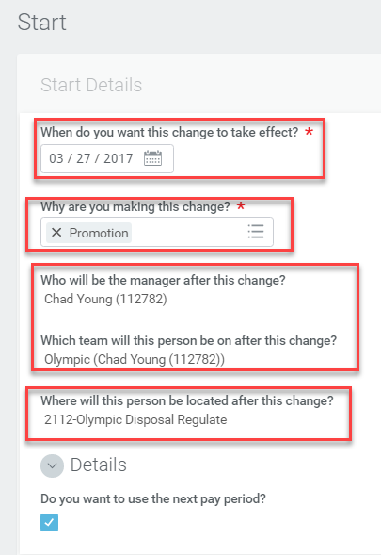
Promotions…Start Details Page (Sending Manager)
Enter the date the promotion should go in effect
Select Promotion
Accurately selecting the new manager will also default the supervisory org or team. Consult an HRIS manager if unsure which manager to select
The location the employee will report to as a result of the promotion
Notes:
Click on Review Time under Actions.

Slide 50

Promotions…Move Page (Sending Manager)
You can choose to:
Backfill Position
Move Headcount
Close Position
Always check this box so recruiting can begin the process to backfill the position
Notes:
Click on Review Time under Actions.

Slide 51
Promotions…Attachments Page (Sending Manager)
Attach any documents that support the promotion
Notes:
Click on Review Time under Actions.

Slide 52
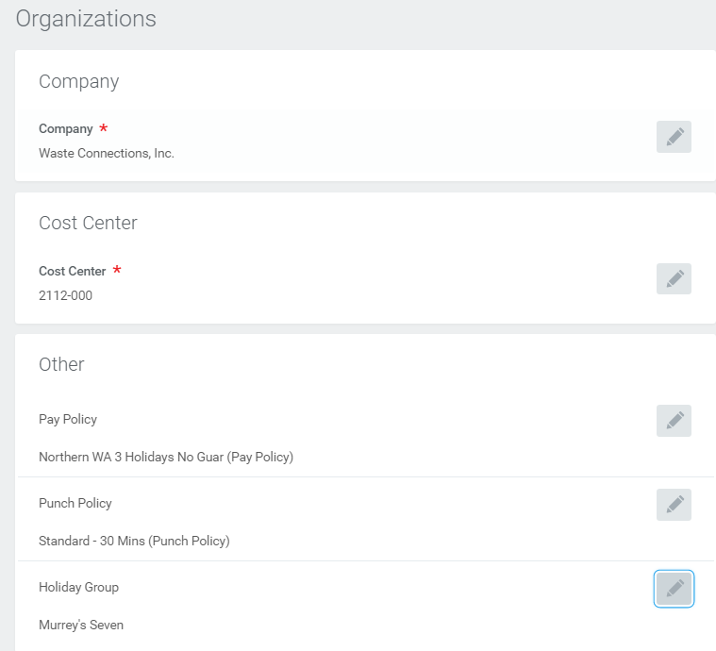
Promotions…Organizations Page (Sending Manager)
Update the organization assignments per the position for the promotion
Notes:
Click on Review Time under Actions.

Slide 53
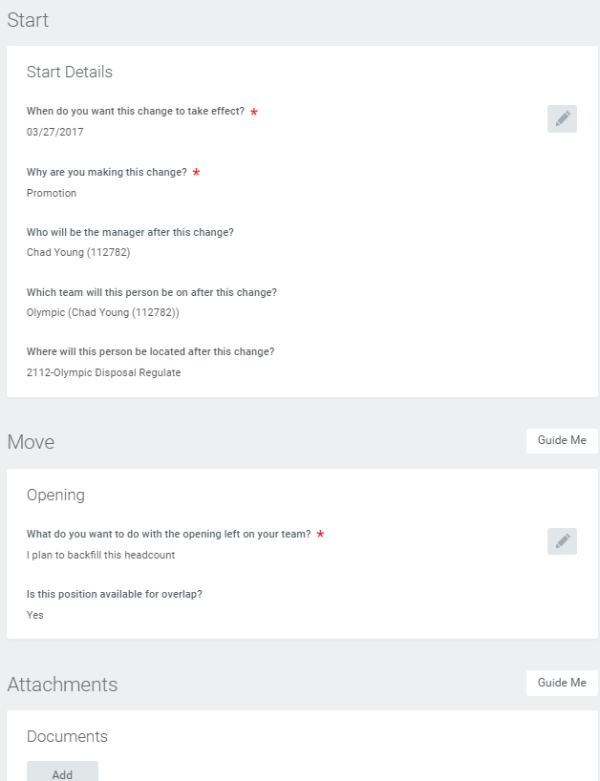
Promotions…Summary Page (Sending Manager)
Review and/or edit all details from the Summary Page.
Click Submit to send to Receiving Manager
Notes:
Click on Review Time under Actions.

Slide 54
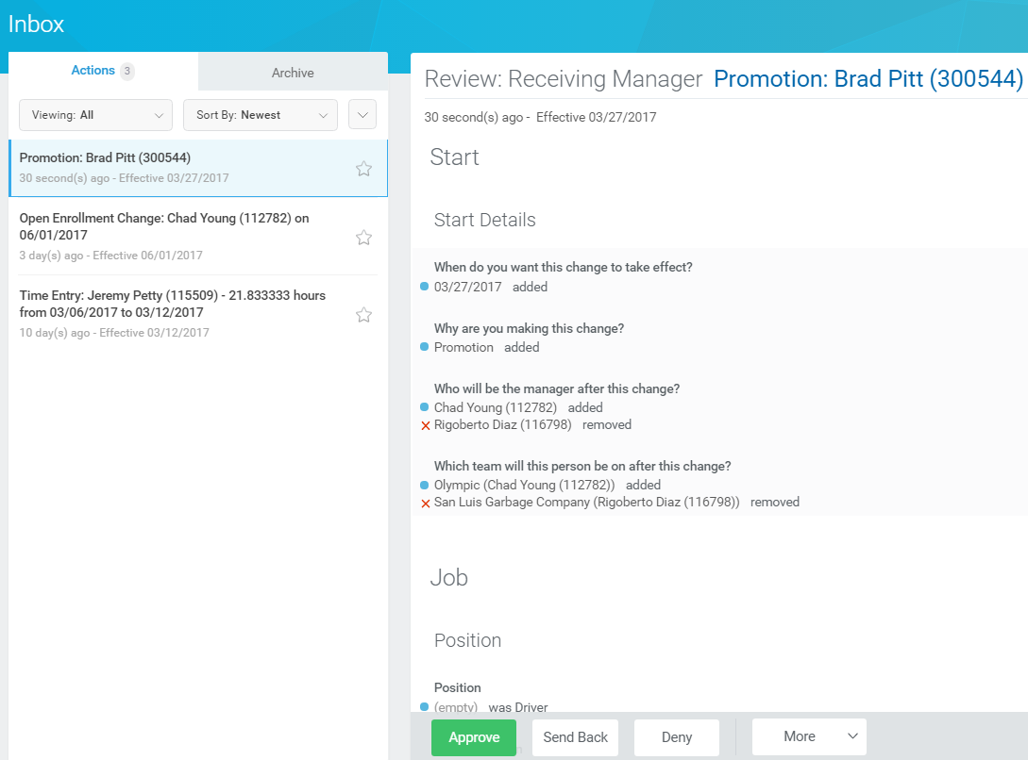
Promotions…Receiving Manager Inbox Notification
Review the information in the Start Details section
Edit as necessary
Save any changes
Notes:
Click on Review Time under Actions.

Slide 55
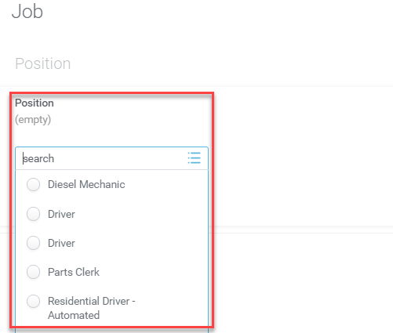
Promotions…Job Details (Receiving Manager)
REMEMBER: To successfully promote an employee, a position MUST have previously been created using the requisition approval process in the Receiving Manager’s supervisory organization.
Select the position for the promotion and save the changes
Notes:
Click on Review Time under Actions.

Slide 56
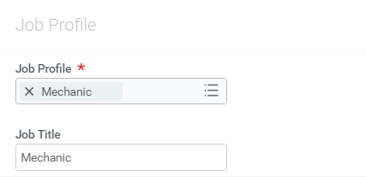
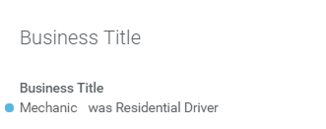
Promotions…Job Profile and Business Title (Receiving Manager)
Select the appropriate Job Profile for the new positon
Keep in mind that the job profile ties back to the GL code
Enter the Business Title
Notes:
Click on Review Time under Actions.

Slide 57
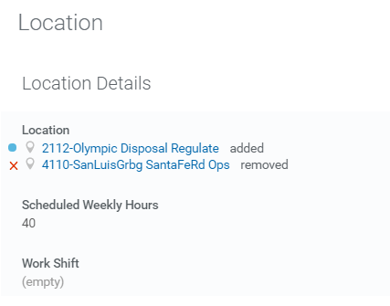
Promotions…Location (Receiving Manager)
If required, edit location details
Notes:
Click on Review Time under Actions.

Slide 58
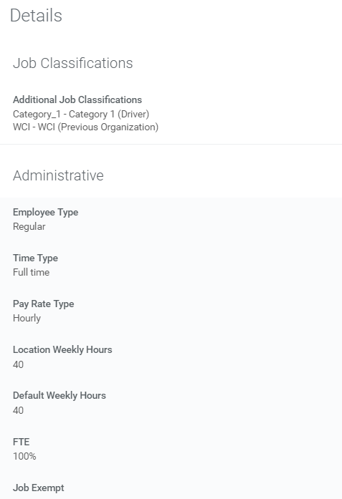
Promotions…Details (Receiving Manager)
If required, edit job classification and administrative details
Notes:
Click on Review Time under Actions.

Slide 59
Promotions…Attachments (Receiving Manager)
Attach any documents that support the promotion
Notes:
Click on Review Time under Actions.

Slide 60
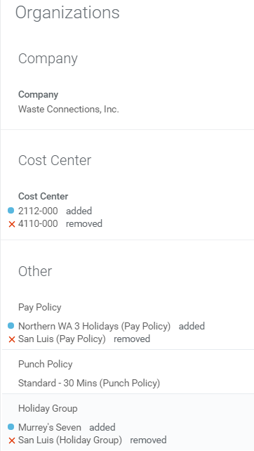
Promotions…Organizations (Receiving Manager)
Edit the allowed organization assignments, if necessary, per the position for the promotion
Notes:
Click on Review Time under Actions.

Slide 61
Promotions…Compensation (Receiving Manager)
Edit compensation by clicking Add for the compensation type or:
Click Add for a salary-based position
Click Add for an hourly-based position
Click Add for a Unit Salary-based position
Notes:
Click on Review Time under Actions.

Slide 62
Promotions…Compensation (Receiving Manager) cont.
Select the appropriate compensation plan
Enter the amount, currency, and frequency
Make sure you have selected the correct option for Frequency
Notes:
Click on Review Time under Actions.

Slide 63
Promotions…Compensation (Receiving Manager) cont.
For hourly employees, the vacation plan must be added again
Click Add
Notes:
Click on Review Time under Actions.

Slide 64
Promotions…Compensation (Receiving Manager) cont.
From the drop-down menu, select “All Compensation Plans”
Choose “Vacation Rate”
Notes:
Click on Review Time under Actions.

Slide 65
Promotions…Compensation (Receiving Manager) cont.
Select the “Vacation Rate” as the compensation plan
Enter the hourly amount the employee will be paid as well as the currency and frequency
Again, make sure you have selected the correct option for Frequency
Notes:
Click on Review Time under Actions.

Slide 66
Promotions…Compensation (Receiving Manager) cont.
Auto-allowance, gas card, etc., please contact your Payroll Partner for assistance in setting up this type of payment in the system
Employee benefits are only affected when moving from union to non-union and vice versa.
Notes:
Click on Review Time under Actions.

Slide 67

Business Title Change
Managers have the capability to edit business titles
Waste Connections

Slide 68
Business Title Change…My Team Worklet
Access the Business Title Change function from the My Team worklet.

Slide 69
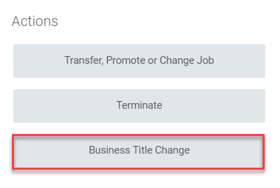
Business Title Change…My Team Worklet cont.
Click here

Slide 70
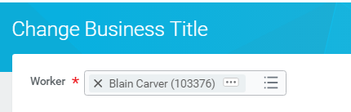
Business Title Change…Select Worker
Enter the name of the worker whose title is to be changed.

Slide 71
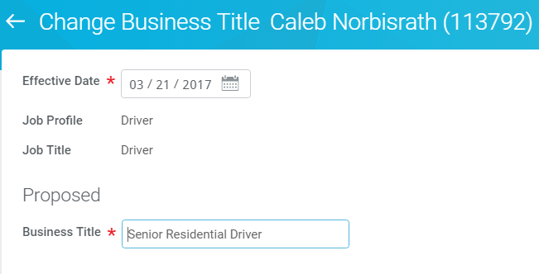
Business Title Change…Change Title
Edit the business title. Click Submit.

Slide 72

Terminations

Slide 73
Terminations…My Team Worklet
Access the Termination function from the My Team worklet.

Slide 74
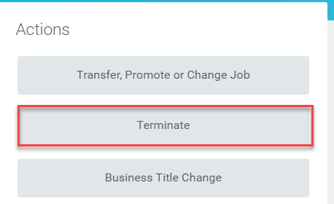
Terminations…My Team Worklet cont.
Click here

Slide 75
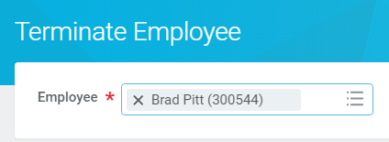
Terminations…Select Worker
Enter the name of the terminated worker. Click OK.

Slide 76
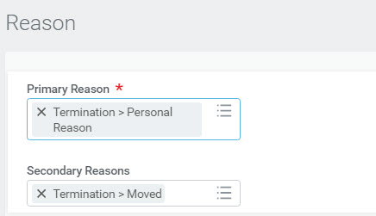
Terminations…Reason
Enter the required primary reason and, if applicable, a secondary reason.

Slide 77
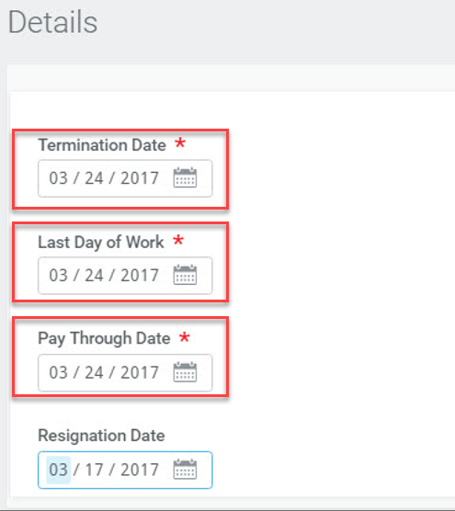
Terminations…Details
Enter the termination date
The “Pay Through Date” MUST MATCH
the “Termination Date”
Enter the employee’s last day of work
Enter the last day the employee should be paid
You may enter the resignation date

Slide 78
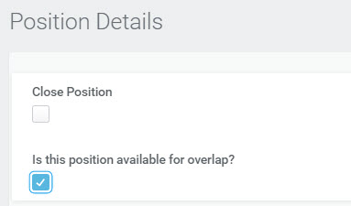
Terminations…Position Details
Check the “Close Position” box to close the position.
Otherwise, click the box indicating the position is available for overlap to ignite the recruiting process to fill the vacancy. Click Submit.
The termination will then route for managerial approval.

Slide 79


Terminations…Comments
It is extremely important to include an employee’s vacation payout in the comments.
Click Submit. The termination will then route for managerial approval.

Slide 80

Resources
Job Aids Currently Available in the Learning Worklet:
Workday Transfer Process for Recruiters and Managers

Slide 81
THANK YOU!!
Upcoming Session:
Get em’ Money – April 5th @ 1:00pm CT or April 6th @ 3:00pm CT
Please register via Emtrain!

